Slide 1
KIDNEY AND SPLEEN
BY
Dr. F.O. OPOOLA

Slide 2
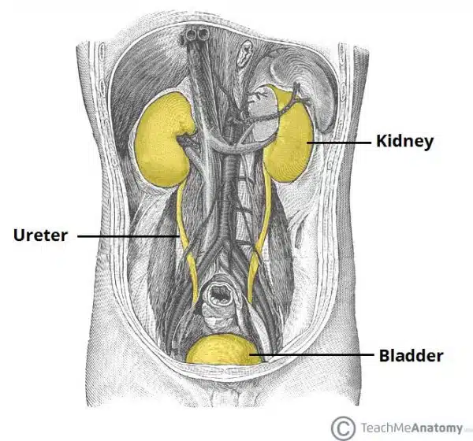
KIDNEY
Overview of the urinary tract.

Slide 3
Introduction
Anatomical position
Structure
Anatomical relation
Vasculation
Innervation
lymphatic

Slide 4
Anatomical Position
The kidneys lie retroperitoneally (behind the peritoneum) in the abdomen, either side of the vertebral column.
They typically extend from T12 to L3, although the right kidney is often situated slightly lower due to the presence of the liver. Each kidney is approximately three vertebrae in length.
The adrenal glands sit immediately superior to the kidneys within a separate envelope of the renal fascia.

Slide 5
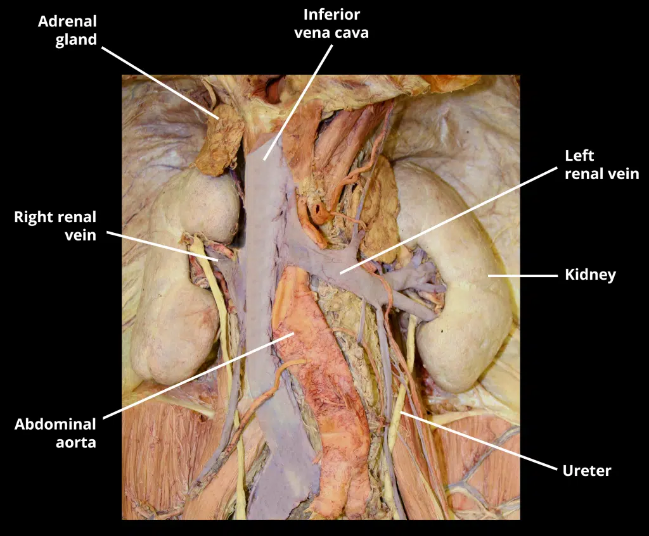
Prosection of the kidney within the abdominal cavity

Slide 6
Venous Drainage
The kidneys are drained of venous blood by the left and right renal veins. They leave the renal hilum anteriorly to the renal arteries, and empty directly into the inferior vena cava.
As the vena cava lies slightly to the right, the left renal vein is longer, and travels anteriorly to the abdominal aorta below the origin of the superior mesenteric artery. The right renal artery lies posterior to the inferior vena cava.
Lymphatics
Lymph from the kidney drains into the lateral aortic (or para-aortic) lymph nodes, which are located at the origin of the renal arteries.

Slide 7
Kidney Structure
The kidneys are encased in complex layers of fascia and fat. They are arranged as (deep to superficial):
Renal capsule – tough fibrous capsule.
Perirenal fat – collection of extraperitoneal fat.
Renal fascia (also known as Gerota’s fascia or perirenal fascia) – encloses the kidneys and the suprarenal glands.
Pararenal fat – mainly located on the posterolateral aspect of the kidney.

Slide 8
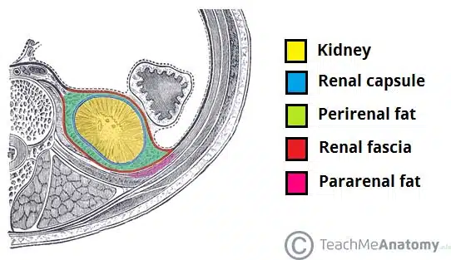
External structures of the kidney

Slide 9
Internally, the kidneys have an intricate and unique structure.
The renal parenchyma can be divided into two main areas – the outer cortex and inner medulla. The cortex extends into the medulla, dividing it into triangular shapes – these are known as renal pyramids.
The apex of a renal pyramid is called a renal papilla. Each renal papilla is associated with a structure known as the minor calyx, which collects urine from the pyramids. Several minor calices merge to form a major calyx.
Urine passes through the major calices into the renal pelvis, a flattened and funnel-shaped structure. From the renal pelvis, urine drains into the ureter, which transports it to the bladder for storage.
The medial margin of each kidney is marked by a deep fissure, known as the renal hilum. This acts as a gateway to the kidney – normally the renal vessels and ureter enter/exit the kidney via this structure.

Slide 10
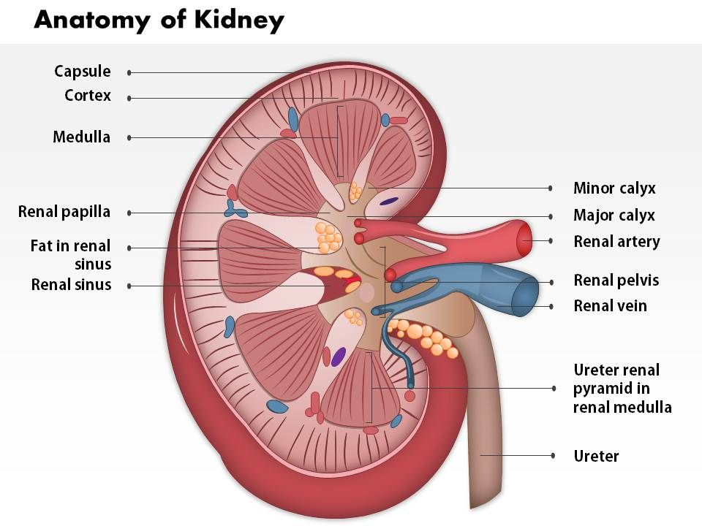

Slide 11
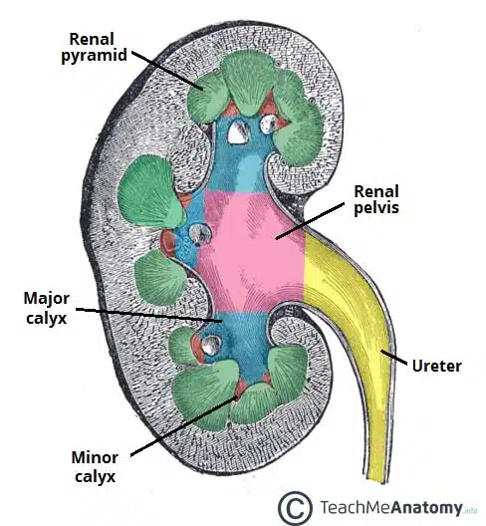
Internal structure of the kidney

Slide 12
Anatomical Relations
The kidneys sit in close proximity to many other abdominal structures which are important to be aware of clinically:
 | Anterior | Posterior
Left | Suprarenal gland Spleen Stomach Pancreas Left colic flexure Jejunum | Diaphragm 11th and 12th ribs Psoas major, quadratus lumborum and transversus abdominis Subcostal, iliohypogastric and ilioinguinal nerves
Right | Suprarenal gland Liver Duodenum Right colic flexure | Diaphragm 12th rib Psoas major, quadratus lumborum and transversus abdominis Subcostal, iliohypogastric and ilioinguinal nerves

Slide 13
Arterial Supply
The kidneys are supplied with blood via the renal arteries, which arise directly from the abdominal aorta, immediately distal to the origin of the superior mesenteric artery. Due to the anatomical position of the abdominal aorta (slightly to the left of the midline), the right renal artery is longer, and crosses the vena cava posteriorly.
The renal artery enters the kidney via the renal hilum. At the hilum level, the renal artery forms an anterior and a posterior division, which carry 75% and 25% of the blood supply to the kidney, respectively.
Five segmental arteries originate from these two divisions.
The avascular plane of the kidney (line of Brodel) is an imaginary line along the lateral and slightly posterior border of the kidney, which delineates the segments of the kidney supplied by the anterior and posterior divisions. It is an important access route for both open and endoscopic surgical access of the kidney, as it minimises the risk of damage to major arterial branches.

Slide 14
Each segmental artery divides to form interlobar arteries. They are situated either side every renal pyramid.
These interlobar arteries undergo further division to form the arcuate arteries.
At 90 degrees to the arcuate arteries, the interlobular arteries arise.
The interlobular arteries pass through the cortex, dividing one last time to form afferent arterioles.
The afferent arterioles form a capillary network, the glomerulus, where filtration takes place.
The capillaries come together to form the efferent arterioles. In the outer two-thirds of the renal cortex, the efferent arterioles form what is a known as a peritubular network, supplying the nephron tubules with oxygen and nutrients. The inner third of the cortex and the medulla are supplied by long, straight arteries called vasa recta.

Slide 15
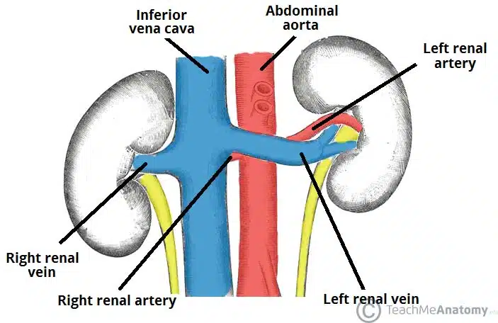
Arterial and venous supply to the kidney

Slide 16
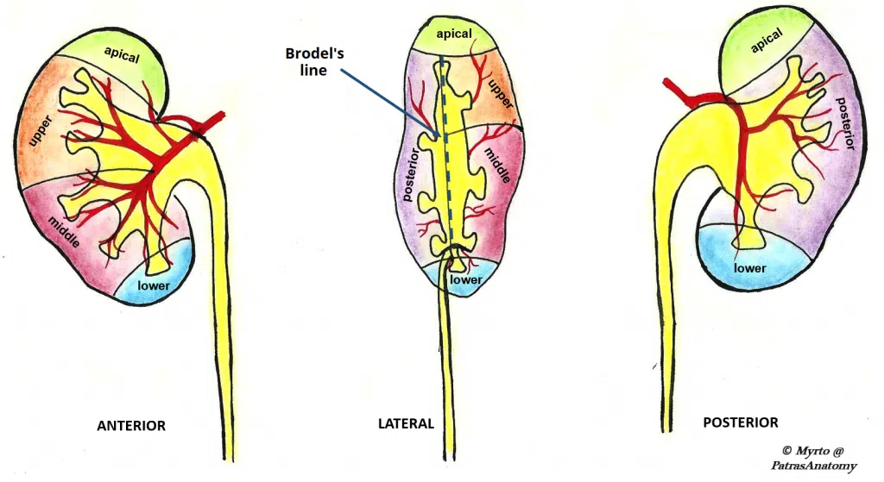
Arterial supply to the kidney can be divided into five segments

Slide 17
SPLEEN

Slide 18
Anatomical Position
The spleen is located in the upper left quadrant of the abdomen, under cover of the diaphragm and the ribcage – and therefore cannot normally be palpated on clinical examination (except when enlarged).
It is an intraperitoneal organ, entirely surrounded by peritoneum (except at the splenic hilum).
The spleen is connected to the stomach and kidney by parts of the greater omentum – a double fold of peritoneum that originates from the stomach:
Gastrosplenic ligament – anterior to the splenic hilum, connects the spleen to the greater curvature of the stomach.
Splenorenal ligament – posterior to the splenic hilum, connects the hilum of the spleen to the left kidney. The splenic vessels and tail of the pancreas lie within this ligament
Between these two ligaments is the lesser sac.

Slide 19
In humans, the spleen is in the upper left quadrant of the abdomen, beneath the diaphragm and adjacent to the stomach. It is a fist-sized organ. In adult humans, a typical spleen is around 12 cm in length, 7 cm in width, and 4 cm in thickness, weighing approximately 150-200 grams. The size depends on height, weight, and the level of congestion, but not age or sex. The spleen has a soft, spongy texture and a purplish hue due to its rich blood supply.

Slide 20
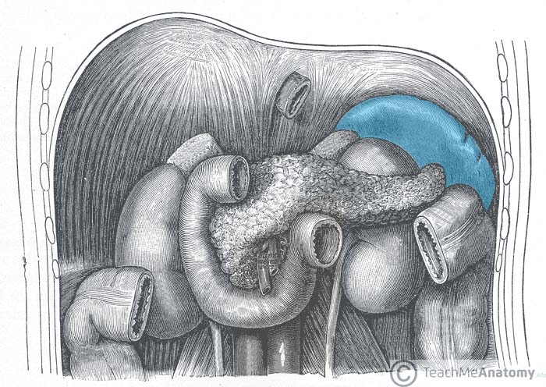
Figure 1 ;The anatomical position of the spleen in the abdomen.

Slide 21
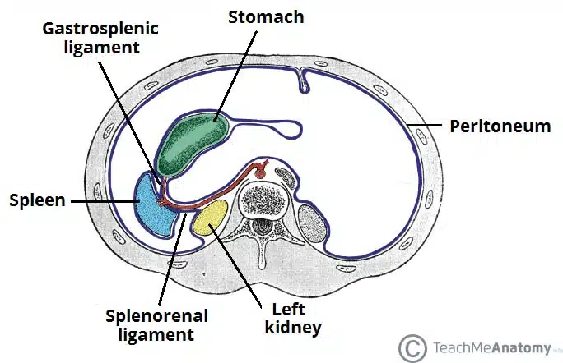
Figure 2; The ligaments of the spleen. Note how the splenic vessels run within the splenorenal ligament.

Slide 22
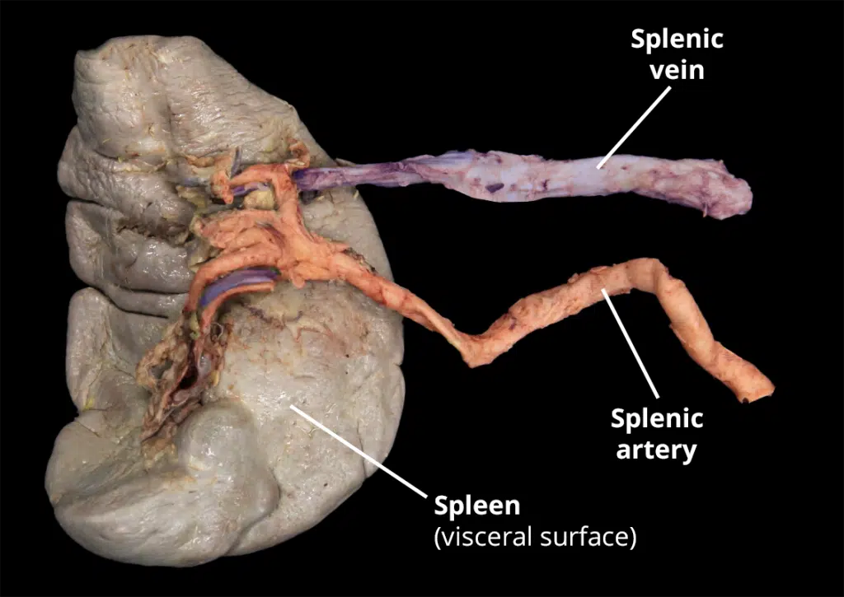
Dissection of the visceral surface of the spleen, how the splenic artery divides into 5 branches, each supplying vascular segment of the spleen

Slide 23
Structure
The spleen has a slightly oval shape. It is covered by a weak capsule that protects the organ whilst allowing it to expand in size.
The outer surface of the spleen can be anatomically divided into two:
Diaphragmatic surface – in contact with diaphragm and ribcage.
Visceral surface – in contact with the other abdominal viscera.
It has anterior, superior, posteromedial and inferior borders. The posteromedial and inferior borders are smooth, whilst the anterior and superior borders contain notches.
In enlargement of the spleen (known as splenomegaly), the superior border moves inferomedially, and its notches can be palpated.

Slide 24
Anatomical Relations
It lies in close proximity to other structures in the abdomen:
Anterior | Posterior | Inferior | Medial
Stomach | Diaphragm Left lung Ribs 9-11 | Left colic flexure (splenic flexure) | Left kidney Tail of the pancreas
Proximity to Other Organs
The spleen rests between the stomach and the left kidney, with its convex surface facing the diaphragm and its concave surface in contact with the stomach, pancreas, and left kidney. This proximity to major organs underscores its role in systemic physiology and pathology.

Slide 25
Functions of the Spleen
The spleen performs multiple critical functions:
Hematopoiesis: The spleen produces blood cells in a fetus. While it stops producing red blood cells after the 5th month of gestation, it continues making lymphocytes (a type of white blood cell).
Blood Filtration: The spleen filters blood, removing aged or damaged red blood cells and recycling iron.
Immune Response: The spleen detects and responds to pathogens, producing antibodies and activating lymphocytes.
Reservoir Function: The spleen stores blood, platelets, and monocytes, releasing them during hemorrhage or infection.
Phagocytosis: Macrophages in the spleen engulf and destroy pathogens and cellular debris.

Slide 26
Embryonic Development
The spleen is unusual compared with other abdominal organs in that it derives from mesenchymal tissue (the dorsal mesentery). In contrast, most gut organs derive from the endoderm. Even so, the spleen shares the blood supply (the celiac trunk) with these other organs.

Slide 27
Possible Problems With the Spleen
Ruptured Spleen
A ruptured spleen is a medical emergency often resulting from trauma, such as a car accident or sports injury. The spleen’s delicate tissue can tear, leading to internal bleeding. Symptoms include abdominal pain, tenderness, and signs of hypovolemic shock (e.g., low blood pressure, rapid heart rate). A ruptured spleen is potentially fatal due to significant blood loss, so it requires immediate surgical intervention.
Enlarged Spleen (Splenomegaly)
Splenomegaly refers to an enlarged spleen. This results from a variety of causes, including:
Infections: Viral (e.g., mononucleosis), bacterial (e.g., tuberculosis), parasitic (e.g., malaria).
Liver Diseases: Cirrhosis leading to portal hypertension.
Hematologic Disorders: Leukemia, lymphoma, hemolytic anemia.
Inflammatory Diseases: Rheumatoid arthritis, systemic lupus erythematosus.
Metabolic Disorders: Gaucher disease, Niemann-Pick disease.
Symptoms of splenomegaly include pain or fullness in the left upper abdomen, fatigue, and increased susceptibility to infections. Treatment depends on the underlying cause and involves addressing the primary condition or, in severe cases, removal of the spleen or splenectomy.

Slide 28
Can You Live Without a Spleen?
A person can live without a spleen, but its absence compromises the immune system. Splenectomy (surgical removal of the spleen) is sometimes necessary due to trauma, disease, or cancer.
Post-splenectomy, individuals are more susceptible to infections, particularly from encapsulated bacteria like Streptococcus pneumoniae, Neisseria meningitidis, and Haemophilus influenzae.
Prophylactic antibiotics and vaccinations aid in managing this increased risk.

